Slide 1
Social Reform Poster
Chapter 12

Slide 2
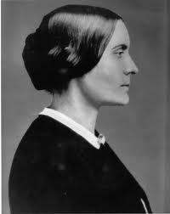
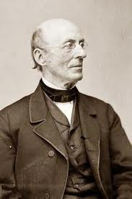
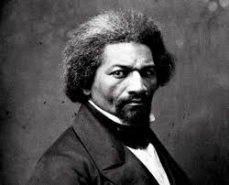
Remember………
Chapter 12 is filled with people and movements which tried to make society better for ALL Americans
Your poster should advocate for one of those social reform movements

Slide 3
Directions
Create a poster which shows your support for one of the following reform movements in Chapter 12:
Second Great Awakening (415)
Temperance Movement (416)
Prison Reform (416)
Reforms for Mentally Ill (417)
Education Reform (417)
Abolitionist Movement (422)
Women's Rights (427)

Slide 4
Directions
Your poster MUST include
Saying (3 points)
Picture (3 points)
Purpose (4 points)
Creativity/Neatness (5 points)
total: 15 points
The purpose of your poster should be clear. By looking at the reform poster I should be able to tell what you are advocating for.

Slide 7
